Slide 1

GPA Calculator
By Zachary Vickery

Slide 2
What The Program Does?
This program is a GPA calculator that allows the user to have a choice to either enter information to calculate their GPA or view their GPA through getting a file. This uses for loops in both enter info and get file, if statements in main, get file, and enter info.

Slide 3
Enter Info
When the user enters 0 to enter information (if), I will first prompt them to enter their name. It will store that name in the txt file
A sort of like chart will output of which grades are assigned to the decimal. Example: A+ = 4.0 B = 3.7.
A for loop is used to prompt the user to enter class credits and grade for the five classes
After the credits and grades are inputted for the five classes, it use the calculateGpa() function to calculate the students GPA.
It will then tell the user their GPA.

Slide 4
Get File
When the user enters 1 to get the txt file(if), it will check if the file even exists or not.
If the file does not exist, then it will output "File not found. Start over".
If the txt file DOES exist, it will use fscanf and printf to output the class credits, class grades (for loop), and student's GPA. Also, it's neat (I think).

Slide 5
Bad news
Get file only half works (I wish I was joking(I also felt confident this would be easy)) :(
GPA won't display and class grade does not display in get file (real?)

Slide 6
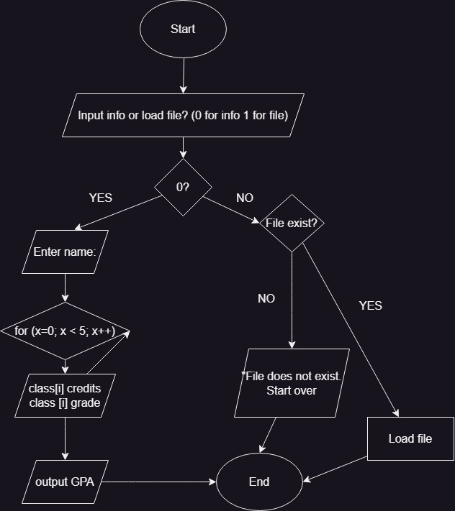

Flowchart?? I guess

Slide 7
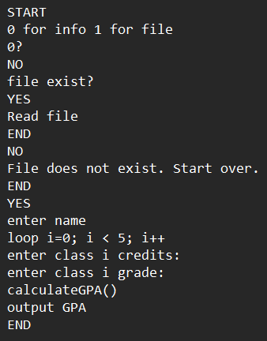
Psdeudocode?? Sure...

